Slide 1
IB English Language and Literature
6 ELL SL 4
2019 - 2020
Shape of the Week (6):
Lesson 1: Exams Review plus COADF
Lesson 2: Exams Review plus COADF
Lesson 3: COADF

Slide 2


SCHOOL ASSESSMENT TERM 3
☑ PRELIMS!!!

Slide 3
General Outline Term 3
WEEK 1 Paper 2 Prelim Prep
WEEK 2 Paper 1 Prelim Prep
WEEK 3 Prelims
WEEK 4 Prelims
WEEK 5 WT finalisation
WEEK 6 Chronicle
WEEK 7 Chronicle
WEEK 8 Chronicle
WEEK 9 Chronicle

Slide 4



We are still a digital classroom!

Slide 5

Homework
Be prepared: Bring Chronicle
Read Context Documents on Managebac, Firefly.
Continue to clean up Written Task.

Slide 6
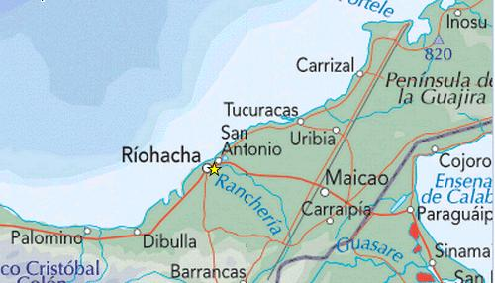
Chronicle of a death foretold: setting
It takes place in a small, Latin American river village off the coast of the Caribbean in the 1950s. Once a busy center for shipping and ocean-going ships, the town now lacks commerce as a result of shifting river currents.

Slide 7
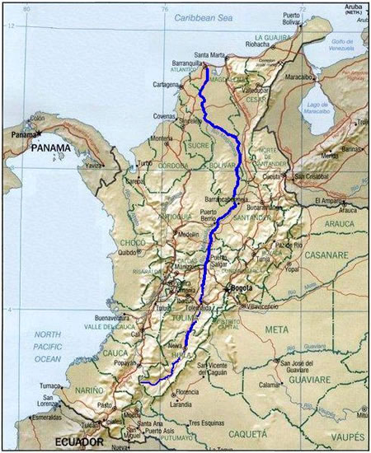
Chronicle of a death foretold: setting
The events evolve over a two-day time period. A wedding has taken place the night before. On the day of the murder, most of the townspeople have hangovers from the wedding reception. Because a visit from the bishop is expected, however, a festive air prevails.

Slide 8
Setting: the society
Pre-Vatican II Catholicism dominated society.
  Birth
  Education
  Marriage
  Relationships
  Work
  Justice
  Death
Gender expectations/ sexism is extreme: there is a conflict and division in the way men and women are supposed to act and interact.
Class and Racial tensions

Slide 9
QUIZ 1

Slide 10
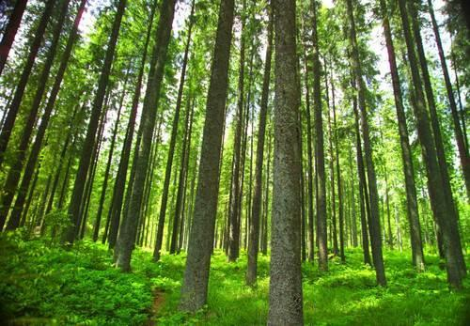
What two significant events are mentioned in the first sentence of the novel? How do you think they correlate?
Santiago Nasar woke up at 5:30 in the morning due to the bishop coming/ going to die that day.
realism / magical. Meeting member of religious (deals w/ supernatural) hierarchy/ Meeting supernatural realm.
How many years have passed since S Nasar’s death? Why do you think the narrator waits so many years to return to the village to investigate the murder?
27… explains (using TRUE STORY NOTES)

Slide 11

Briefly summarise Santiago’s dream the morning of his death. What does his mother believe dreams about birds indicate?
Dreams of being in a grove of timber trees in drizzling rain – then bird shit.
Birds – foretell health.
What is Santiago’s mother’s name? For what is she well known?
Placida Linero.
Interpreting dreams.

Slide 12
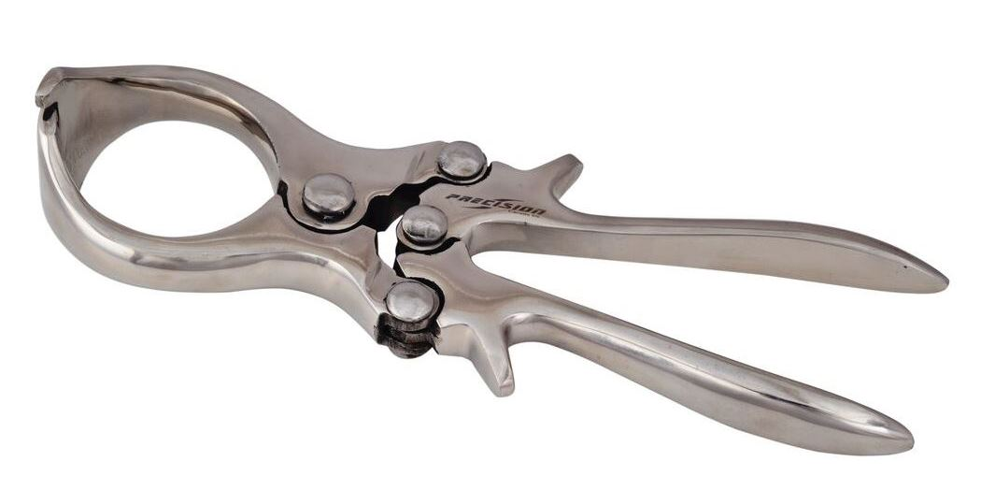
What is the Divine Face? What does Santiago do there? Symbolism?
Sanitago’s inherited ranch.
Castrates (gelds) calves.
Masculine Sexuality and this story!
Why does Santiago’s mother blame herself for his death?
Misinterpreted dream, shut the door on him.

Slide 13
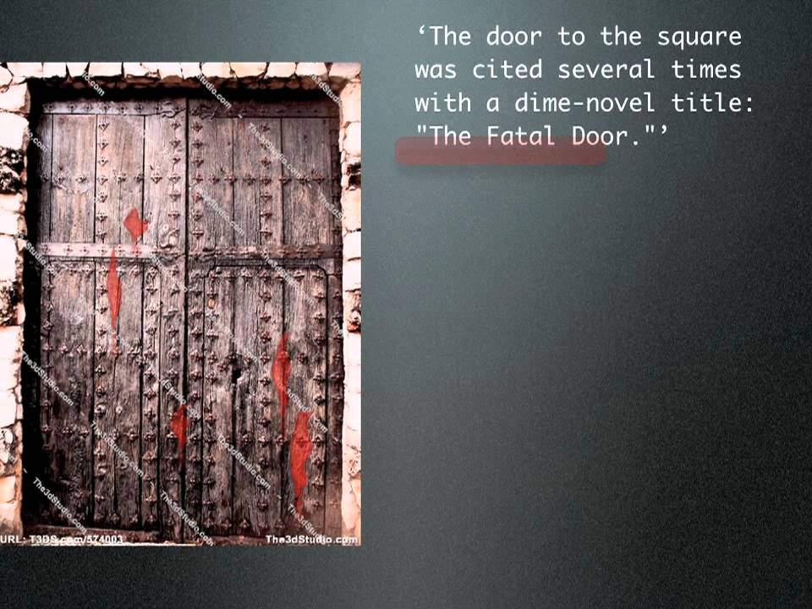
Who are Victoria Guzman and Divina Flor? How does Victoria feel about Santiago? What do you think his reaction to Divina indicates?
They are the maids of the Nasar home; mother and daughter. Victoria hates him, and his actions toward Divina indicate that she will be what Victoria was to his father.
What is the Fatal Door? Why is this door important to the plot?
It is the door he leaves the day of his death, but he usually never leaves through the door.

Slide 14
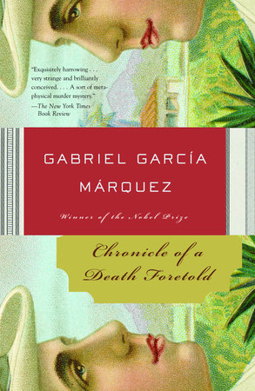
How do Victoria and Divina learn about the murder plot? Why don't they warn Santiago? What does Divina do in a futile attempt to help him? What do you think this indicates about her?
A beggar told them of the murder.
Victoria hates Santiago, Divina is too scared.
Divina leaves the doors unbarred.
She still cares for his life, despite his actions.
What does an unidentified person do in attempt to warn Santiago? Why does this fail?
They slipped a note under the door, but no one saw it.

Slide 15
QUIZ 2

Slide 16
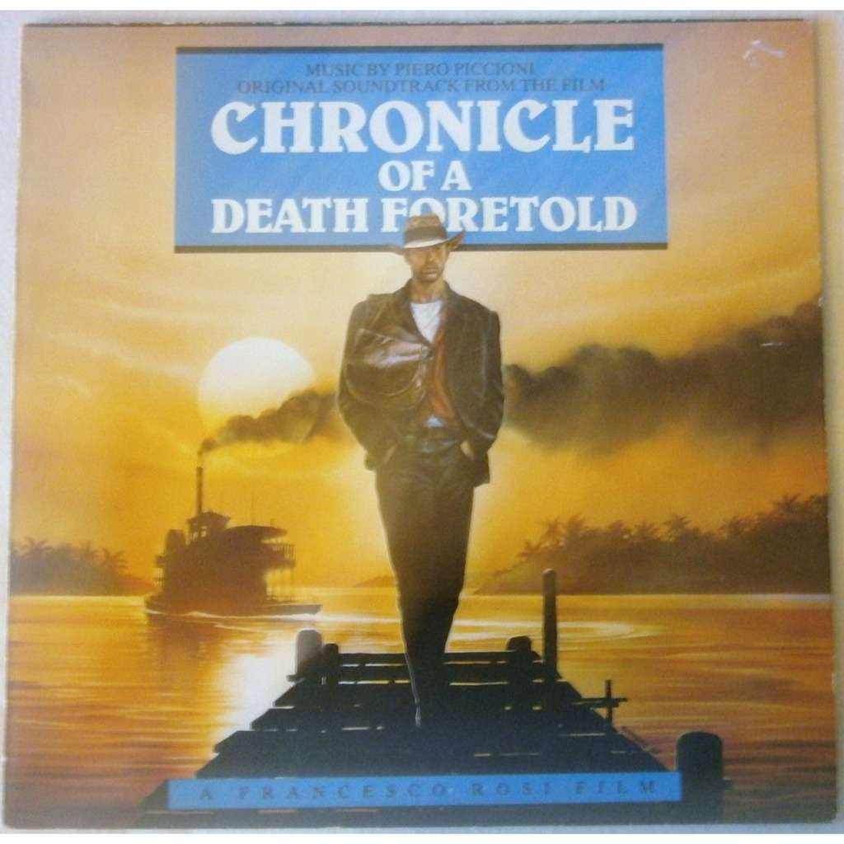
Identify the two men who plan to kill Santiago. How does the narrator feel about them?
Pablo and Pedro Vicario, he thought they were honorable and their families knew each other.
Identify the characters and explain their interaction with Santiago on the day of his death: Margot, Cristo Bedoya, Don Lazaro Aponte, Father Carmen Amador.
Margot sees him the morning of, invites him to breakfast.
Cristo Bedoya attempts to warn Santiago.
Don Lazaro Aponte does nothing, likes dominoes
Father forgets to warn Santiago of his impending murder.

Slide 17
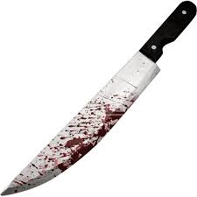
Why does the narrator find it strange that his sister Margot does not know about the plot to murder Santiago? How does Margot feel about Santiago?
She was with him the morning of his murder, in the middle of town. Margot thinks he is a catch.
Why does Angela Vicario get returned home the night of her wedding?
Because she wasn't a virgin.

Slide 18
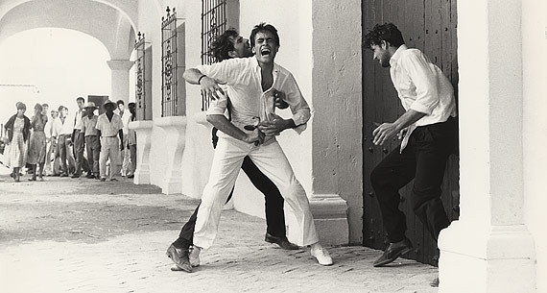
Who is Luisa Santiaga and what is her connection to Santiago and the Vicario family?
The narrator's mother; she is Santiago's godmother and is the cousin of Purisma.
What does Luisa do when she learns of the death threat?
Go to the Nasar home to warn him.
What news reaches Luisa before she gets to Santiago's home?
Santiago's dead.

Slide 19

Short Answer!
What does the cook, Victoria Guzman, think of Santiago?
How does Santiago treat Victoria's daughter, Divina Flor?
What does this suggest about the Santiago's treatment of women, and what does this chapter suggest about the status of women in this town?
Write a PETEL paragraph the black question analytically without falling into description!

Slide 20
From the start it is established that Santiago Nasar is going to die, his death is the main point of the entire narration either in the past or twenty seven years later.
Starts off with massive tension but we are then showered with the mundane which actually increases our anticipation for his death.

Slide 21
Homework
Be prepared: Bring Chronicle
Read Context Documents on Managebac, Firefly.
Continue to clean up Written Task.

